Slide 1
Knock Knees
Genu Valgum

Slide 2
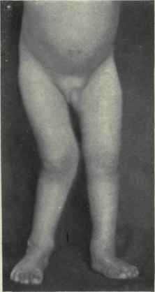
DEFINITION
Defined by position of knees such that, when standing with knees together, the medial malleoli are not touching.

Slide 3
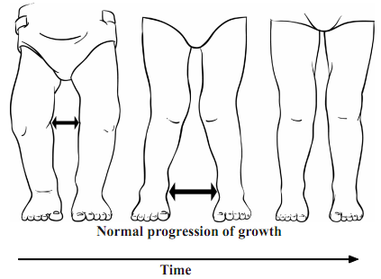
Normal Development
Most children are “bowlegged” from birth until around 3 years old, then become “knock kneed” until age 4 to 5, and straighten towards adult alignment by age 6 to 7.

Slide 4
CAUSES
Unilateral
Bilateral
Asymmetric growth:
1-Trauma.- growth plate injuries
2-Infection.
3-Tumor to tibia.
Physiological: common
Metabolic: renal osteodystrophy, rickets, hypophosphatemia.
Neuromuscular: cerebral palsy.
Haemotological: myelodysplsia
Skeletal dysplasia: congenital dislocation of patella

Slide 5
Examination
Gait –The typical gait pattern is circumduction, requiring that the individual swings each leg outward while walking in order to take a step without striking the planted limb with the moving limb.
Height – short stature associated with dysplasia
Inspection - ( front, back & side)
Notes:
Short = rickets or dysplasia
Gentle bowing involving the femur-distal⅓ and tibia-junc.of middle and proximal ⅓ s

Slide 6
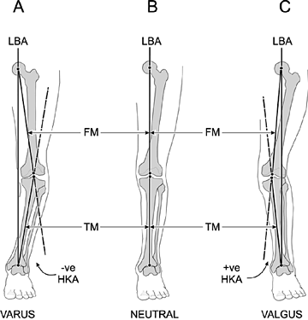
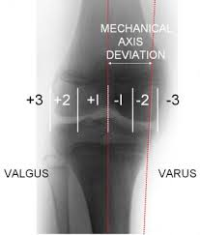
cont
Measurements
Inter malleolar distance,
lateral distal femoral angle – N – 84 degrees( 6 degrees valgus),
Mechanical axis deviation
Site of valgus
Anterior medial knee pain common due to the altered knee mechanics

Slide 7
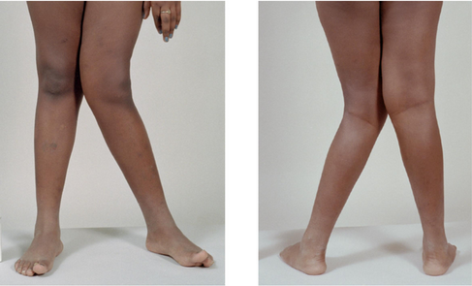
Presentation
Knees touch each other while standing.
Legs are curved inwardly.
Too much distance between feet.

Slide 8
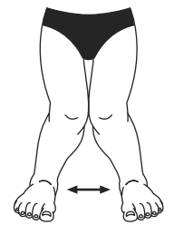
Measurement of intermalleolar distance
intermalleolar distance is a Distance between two malleoli when the knees are gently touching with legs in adduction.
Up to 3 and a half inches (9 centimeters) with child lying down is acceptable.

Slide 9
Possible Complications
Difficulty walking (very rare).
Self-esteem changes related to cosmetic appearance of knock knees.
If left untreated (for patients with intermalleolar distance which is more than 9 cm and for age group < 7 years), knock knees can lead to early arthritis of the knee.

Slide 10
Management
RAPRIOP

Slide 11
Reassurance
1- Most parents are happy to be reassured that their child's deformity is within normal limits and will disappear.
2- Some may need their confidence boosted by returning for fresh measurements to be made six-monthly until they are convinced it is disappearing.
3- For those who are still sceptical, radiographic examination may be sufficient to alleviate their anxiety with or without the addition of an orthopaedic opinion.

Slide 12
Advice
To measure natural improvement, Advice Parents to take photographs of the child in standing with their kneecaps pointing forward every 6 months.

Slide 13
Prescription (Treatment)
Non-Operative
Operative
Special shoes, exercise programs, splints and braces are not recommended, as these conditions usually correct and improve over time with normal growth.
Epiphysiodesis (physeal stapling) of medial side, or corrective osteotomy in children < 10 years old with intermalleolar distance < 10 cm.

Slide 14
When to Refer ?
Age > 7 years with knock knees.
Unilateral problem i.e Asymmetry of legs.
Intermalleolar distance > 3.5 inches (9 cms).
Associated symptoms e.g Pain, Limp.

Slide 15

Indicators of Serious Disease
Pronounced asymmetry
Short stature
Other skeletal abnormalities
Intermalleolar separation greater than 3.5 inches

Slide 16
Investigations
X-rays
Laboratory tests
No X-ray required until < 18 months of age, then AP and lateral standing full leg length views.
CBC, phosphorus, creatinine and alkaline phosphotase may be ordered if a systemic or metabolic abnormality is suspected.

Slide 17
RADIOLOGY
X- RAYS
Indicated for anyone with an intermall distance of > 3.5 inches, unilateral
Need to position patellae facing straight then do standing x rays of the entire lower limbs
Supine x ray may also be done
Measure the femoro-tibial angle with a goniometre

Slide 18
Observe (Follow Up)
Observe the patient every 6 months.

Slide 19
Prevention
There is no known prevention for normal knock knees.

Slide 20
Thank you
.

